Slide 1
Machine learning Approaches for Classification and Diameter Prediction of Asteroids .

Slide 2
INDEX
01
Gradient Boosting
02
XGB Classifier
03
Cat Boost

Slide 3
Gradient Boosting
Introduction
Gradient boosting is a method standing out for its prediction speed and accuracy, particularly with large and complex datasets.
Gradient boost algorithm helps us minimize bias error of the model.
Gradient boosting is a machine learning ensemble technique that combines the predictions of multiple weak learners, typically decision trees, sequentially.
It aims to improve overall predictive performance by optimizing the model’s weights based on the errors of previous iterations, gradually reducing prediction errors and enhancing the model’s accuracy.

Slide 4
Gradient Boosting
Advantages
Disadvantages
Generally more accurate compare to other modes,
Train faster especially on larger datasets,
Most of them provide support handling categorical features,
prone to overfitting: this can be solved by applying L1 and L2 regularization penalties. You can try a low learning rate as well;
models can be computationally expensive ,
hard to interpret the final models.

Slide 5
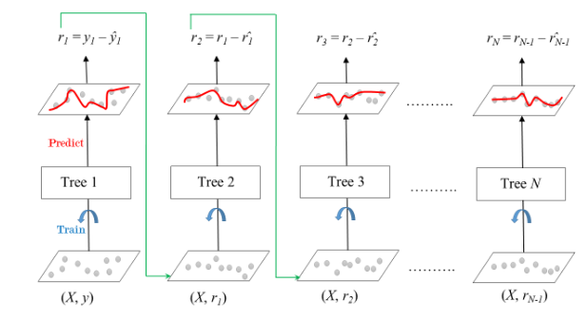
Gradient Boosting
Algorithm
Step 1: Make an initial prediction.
Step 2: Calculate the pseudo-residuals.
Step 3: Build a weak learner.
Step 4: Iterate

Slide 6
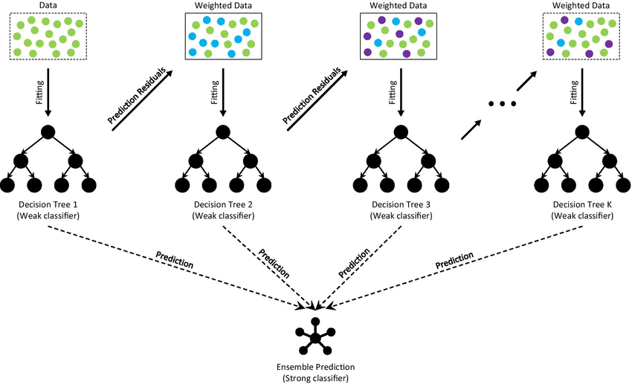

Slide 7
XGB Classifier
eXtreme Gradient Boosting, is a powerful machine learning algorithm known for its efficiency in the predictive task
XGBoost uses a gradient boosting framework which sequentially adds weak learners to correct errors from previous iterations.
XGBoost is fast and effective because it's been finely tuned for speed and performance, making it a top pick for competitions and real-world projects.
The primary objective of the XGBoost classifier is to achieve high accuracy and predictive performance across various machine learning tasks, including classification, regression, and ranking.

Slide 8
XGB Classifier
Advantages
Disadvantages
XGBoost offers exceptional accuracy and efficiency in predictive tasks.
It can handle diverse data types and problems, including classification, regression, and ranking.
It reduces the problem of the overfitting
It can handle missing values in the dataset .
Implementation and parameter tuning can be complex, requiring careful attention.
XGBoost may require more computational resources than simpler algorithms.
Performance is sensitive to hyperparameter settings
The ensemble nature of XGBoost models can make interpretation challenging compared to simpler models like decision trees.

Slide 9
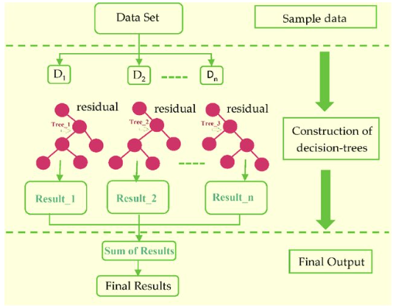
XGB Classifier

Slide 10
Cat Boost
Introduction
CatBoost or Categorical Boosting is an open-source boosting library developed by Yandex.
It is designed for use on problems like regression and classification having a very large number of independent features.
Catboost is a variant of gradient boosting that can handle both categorical and numerical features. It does not require any feature encodings techniques like One-Hot Encoder or Label Encoder to convert categorical features into numerical features.
It also uses an algorithm called symmetric weighted quantile sketch(SWQS) which automatically handles the missing values in the dataset to reduce overfitting and improve the overall performance of the dataset.

Slide 11
Cat Boost
Features
Great quality without parameter tuning.
Categorical features support.
Fast and scalable GPU version.
Improved accuracy.
Fast prediction.
It can be used in both Python and R language.

Slide 12
Cat Boost
Gradient Boosting
Handling Categorical Feature Efficiently
Regularization techniques
Optimized Tree Structure (oblivious trees)
Efficient Gradient Calculation (ordered boosting)
Categorical Feature Embedding

Slide 13
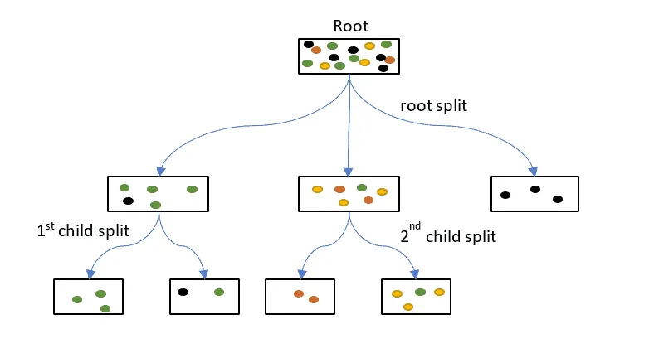
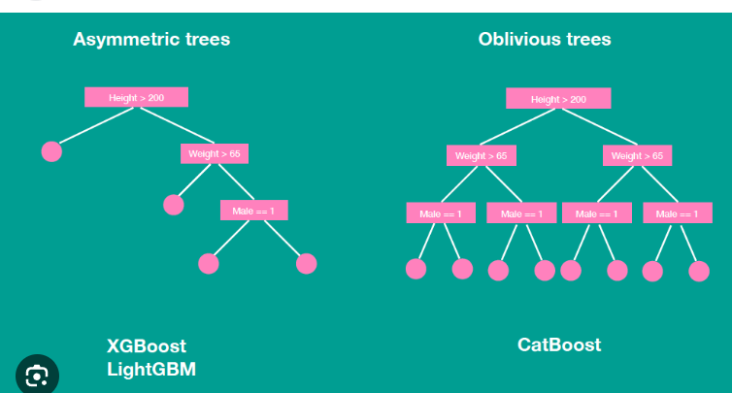

Slide 14
